Slide 1
VTA’s BART Silicon Valley Phase II Extension Project
Downtown-Diridon
Community Working Group Meeting
Tuesday, March 10, 2026

Slide 2
Downtown-Diridon CWG Members
Tony Mirenda, San José Chamber of Commerce
Tala Fatolahzadeh, City of San José ​
Eric Eidlin, City of San José​
Chris Burton, City of San José
Scott Smith, BART
Adina Levin, Friends of Caltrain
Alan Williams, Campus Community Association (Naglee Park)
Bert Weaver, Delmas Park Neighborhood Association
Edward Saum, The Alameda Business Association
Anne Marie Todd, San José State University
Chris Shay, Sharks Sports & Entertainment
Dana Grover, Horace Mann Neighborhood Association
Elizabeth Chien-Hale, Downtown Residents Association
Fernando Cruz-Esparza, Student Rep at San José State University
James Duran, Hispanic Chamber of Commerce
Jeffrey Buchanan, Working Partnerships USA
José Magana, San José Unified School District
Kristen Brown, Silicon Valley Leadership Group
Kohar Scott, San José State University
Martin Flores, Arena Authority
Mike McLean, Adobe
Nate LeBlanc, San José Downtown Association
Ron Gonzales, Hispanic Foundation of Silicon Valley
Sondra Weber, Shasta / Hanchett Park Neighborhood Association; Plant 51 Homeowners Association

Slide 3
AGENDA
CWG Strategic Direction & Update
Phase II Program Update
Diridon Station Design Update
Construction Update
Next Steps
Discussion & Feedback
Notes:
Framing –
Been going through station refinements throughout the project lifecycle the past couple of years – with focus on cost savings effort for past year. Having moved the station infrastructure facilities above ground and found significant cost savings at 28th Street/Little Portugal & Diridon stations, we know there is significant savings in doing so. . Last fall we, looked at station refinements as part of Level 1 cost savings, and based on discussions with City, CWG and the Board, decided to not make changes that would effect the passenger experience (increasing number of escalator runs, etc). Fast forward a year later and we are still working through cost savings to align the project scope with the available funding and looking at all options. Having validated cost savings at the other two underground stations and knowing we needed to find further savings, we are turning over every stone and need to make the refinement at the Downtown station as well.
Greg is going to walk through the cost savings of moving the station infrastructure facilities above ground, then walk through the initial refined station layout. Then we want to focus on gathering feedback today - confirming the City’s key station elements of interest that we’ve heard and discussing the City’s priorities. Then in our next meeting, we can follow up with a discussion of the tradeoffs
And then we’ll walk through our near-term engagement schedule.

Slide 4
Phase II Program Update

Slide 5
Recap of 2025
Winter 2025 Level 2 Cost Savings
Spring 2025 Start of TBM Launch Structure Construction
Summer 2025 Level 3 Tunnel Task Force Evaluation
August/September 2025 Independent Peer Review
October 2025 Project Configuration Approval (53’ TBM for entire alignment)
Fall 2025 Ramping up for design advancement, contract packaging, and FFGA application planning

Slide 6
Current Efforts Underway
Ongoing stakeholder engagement & community outreach
Advancing design towards 60%
Updating baseline cost, schedule and risk
Preparing for FFGA readiness document
Reviewing contract packaging and delivery approaches
West Portal/TBM Launch Structure construction
Evaluating additional early work construction opportunities
Notes:
Note: BART funding (talking point from Erica)

Slide 7
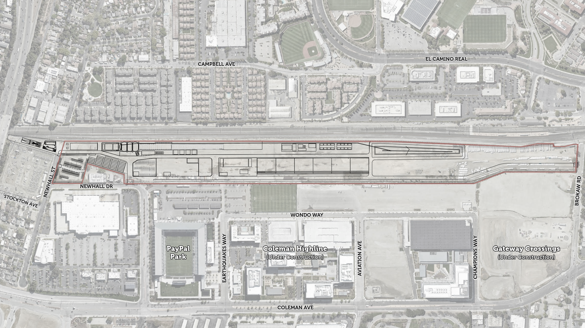
Elements To Be Constructed Before Tunneling Begins
  Construction Staging Area
  Construction Vehicle Access
  Employee Vehicle Access
  Employee Parking Lot
  Site Offices
West Portal/Tunnel Boring Machine Launch Structure
Tunnel Conveyor System
& Gantry Cranes
Tunnel Conveyor System
& Gantry Cranes
Tunnel Conveyor System
& Gantry Cranes
Noise Curtain
Tunnel Lining Factory
Grout Plant
Excavated Materials Bin
Tunnel Lining Storage
Electrical Equipment Installation & Energization
City of Santa Clara
City of San José
N
Notes:
Here is a layout of the site with some key features highlighted.
[Click through] There are three entrances into the site. The entrance on Newhall Street is generally for employee vehicles only, while the entrances on Newhall Drive and Brokaw Road are for construction vehicles. The employee parking lot and site offices are accessed from Newhall Street.
The West Portal is the area where the Tunnel Boring Machine, or TBM, will begin tunneling into the ground, and the TBM shaft will serve as the assembly and eventual launching point for the TBM and accordingly the shaft will house many large support structures. During operation, the Tunnel Boring Machine shaft will also serve to remove excavated soil out of the tunnel and where tunnel lining segments will be brought in through and ultimately installed.
The tunnel lining precast factory and tunnel lining storage is where tunnel lining segments will be constructed and stored. The lining segments will be placed in the tunnel by the TBM as soil is removed to create a structurally sound tube underground. 9 segments make up one ring of the tunnel. The TBM will be able to install 6 rings per day.
The Grout Plant is also integral to the lining of the tunnel. The grout will be used to seal the tunnel lining segments in place as the Tunnel Boring Machine advances and installs them.
The Excavated Materials Bin is where the excavated soils from the tunnel will be stored until hauled offsite to be repurposed or disposed of.
Finally, a noise curtain has been constructed along the west side of the site to reduce noise from construction activities.
Other needed elements and activities that are outlined but not highlighted are the storm water detention basin and pump station, baker tanks and a water treatment plant, (already installed), the verland conveyor system to bring muck from the TBM through the tunnel to the muck bin, cooling towers, clay shock plant, backup generators for TBM power, tunnel ventilation facilities, TBM cradles, jacking frame, tunnel headwall, eye seal and of course the delivery, assembly and testing of the TBM on site.

Slide 8
Risk Assessment of Critical Activities
Predecessor Activities to TBM Launch | Risk to Advance* | Beneficial to Advance Now
PCTL Storage Foundations
Long Lead Procurement for Tunneling
PCTL Plant Set Up
PCTL Initial Casting
Electrical Equipment Installation and Energization
Preconstruction Survey, Instrumentation & Monitoring
Property Protection
TBM Plant Installation and Testing
TBM Shaft Prep & Assembly
Low Risk Activities with High Schedule Benefit
Legend:
Low Risk/High Benefit
Medium Risk/Benefit
High Risk/Low Benefit
* Indicates risk associated with having someone other than the tunnel contractor perform these activities

Slide 9
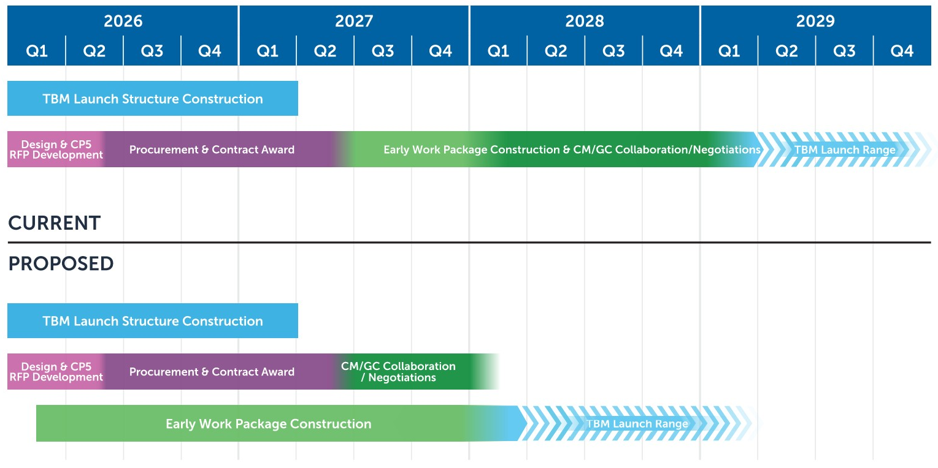


Schedule Considerations
PROPOSED WITH THREE (3) LOW RISK/HIGH BENEFIT EARLY WORKS ACTIVITIES AUTHORIZED
Four Month Schedule Savings
9

Slide 10
Adaptive Plan Update
Explore all feasible options for how BSVII can continue to progress if the Full Funding Grant Agreement (FFGA) is not secured in 2027.
Notes:
Staff conducted a qualitative analysis of various scenarios to advance the project forward.
Let Members know why we're talking about this.

Slide 11
Adaptive Plan Evaluation
Adaptation | Description
A – Maintain Momentum | Maintain critical path using VTA’s pre-award authority granted under the existing FTA Letter of No Prejudice to both advance and possibly accelerate construction utilizing local, regional and state funds.
B – Prioritize Tunnel & One Station (until FFGA receipt) | Limit near-term construction activities to only the tunnel and one station until receipt of FFGA. Commence construction of remaining stations post-FFGA receipt.
* An FFGA would be required under any and all adaptations considered.
Notes:
The challenge with phasing stations is you starting to tunnel from the West, but revenue service will come from the East, making further phasing cost-prohibitive.
C – Station Deferral
Build, open, and operate revenue service from Berryessa to Diridon Station first, remaining stations deferred to a future project.

Slide 12
Adaptive Plan Evaluation
Adaptation | Pros | Cons
A – Maintain Momentum | Allows program to move forward as scheduled. Consistent with Peer Review feedback on the importance of maintaining momentum. Aligns with Federal Administration priority of accelerating project delivery to bring economic benefits to the region sooner. | Higher near-term drawdown of local, regional and state funds. Modest increase in financing costs.
B – Prioritize Tunnel & One Station (until FFGA receipt) | Reduced near-term drawdown of local, regional and state funds. Could allow for early opening of one station while other stations are completed. | Longer overall construction schedule duration. Higher total cost to the program.

Slide 13
Summary of Findings
“Adapt” the project as-needed:
  Maximize the use of the authority granted under the existing FTA Letter of No Prejudice
  Commit local, regional and state funds to critical construction contracts in coordination with state and regional partners.
  Contract packaging and financing plans will prioritize flexibility with FFGA date.
  Maintain project momentum.

Slide 14
Adaptive Plan – Contract Packaging
Reviewing Contract Packaging and various contract models to efficiently advance the project, reduce risk and maintain schedule.
Advancing design now to increase estimate confidence and reduce project risk and contingency.
Solicitating Industry Feedback.
Pushing Non‑Critical Work “to the Right” to Prioritize High‑Value Activities and maintain flexibility for later contract packages.
14

Slide 15
Overview of Delivery Models
Delivery Methods can be viewed on a continuum of responsibility and risk
Greater Owner Role & Risk
Greater Private Role & Risk
Design-Bid-Build
(DBB)
Construction Manager/
General Contractor
(CM/GC)
Progressive Design-Build
(PDB)
Design-Build (DB)
inc. Design-Furnish-Install-Test (DFI)
Other Methods including:
Design-Build-Operate-Maintain-Finance, P3, etc.

Slide 16
Overview of Delivery Models – Continued
Primary project delivery roles during each phase differ for each model
~30% design
~100% design
Owner-Led
Contractor-Led
Planning Phase
Preconstruction Phase
Construction Phase
Traditional Contracting
DBB
Owner
Contractor
Collaborative Contracting
CM/GC, PDB, PDA (P3)
Contractor
Contractor
Contractor
Owner
Owner
Owner
Lump Sum DB Contracting
DB, DBF, DBFM, DBFOM
Owner
Contractor

Slide 17
Target Price/ Incentive-Based Contract
Owner reimburses contractor for actual, allowable, and allocable costs incurred, plus an agreed fee or incentive structure (not a fixed lump sum).
Total contract value is controlled by a target cost or not‑to‑exceed (NTE) ceiling, with formal approval required to exceed that ceiling.
Common forms include Cost‑Plus‑Fixed‑Fee, Cost‑Plus‑Incentive‑Fee, and Target Price with Gain-share/Pain-share mechanism.
Target pricing with a gain-share/pain-share mechanism was recognized under FTA's January 2025 Project and Construction Management Guideline.
Model adopted for delivering complex tunneling programs in U.K., Australia, and Canada
17

Slide 18
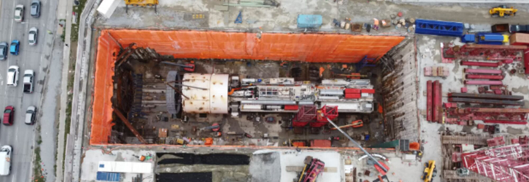
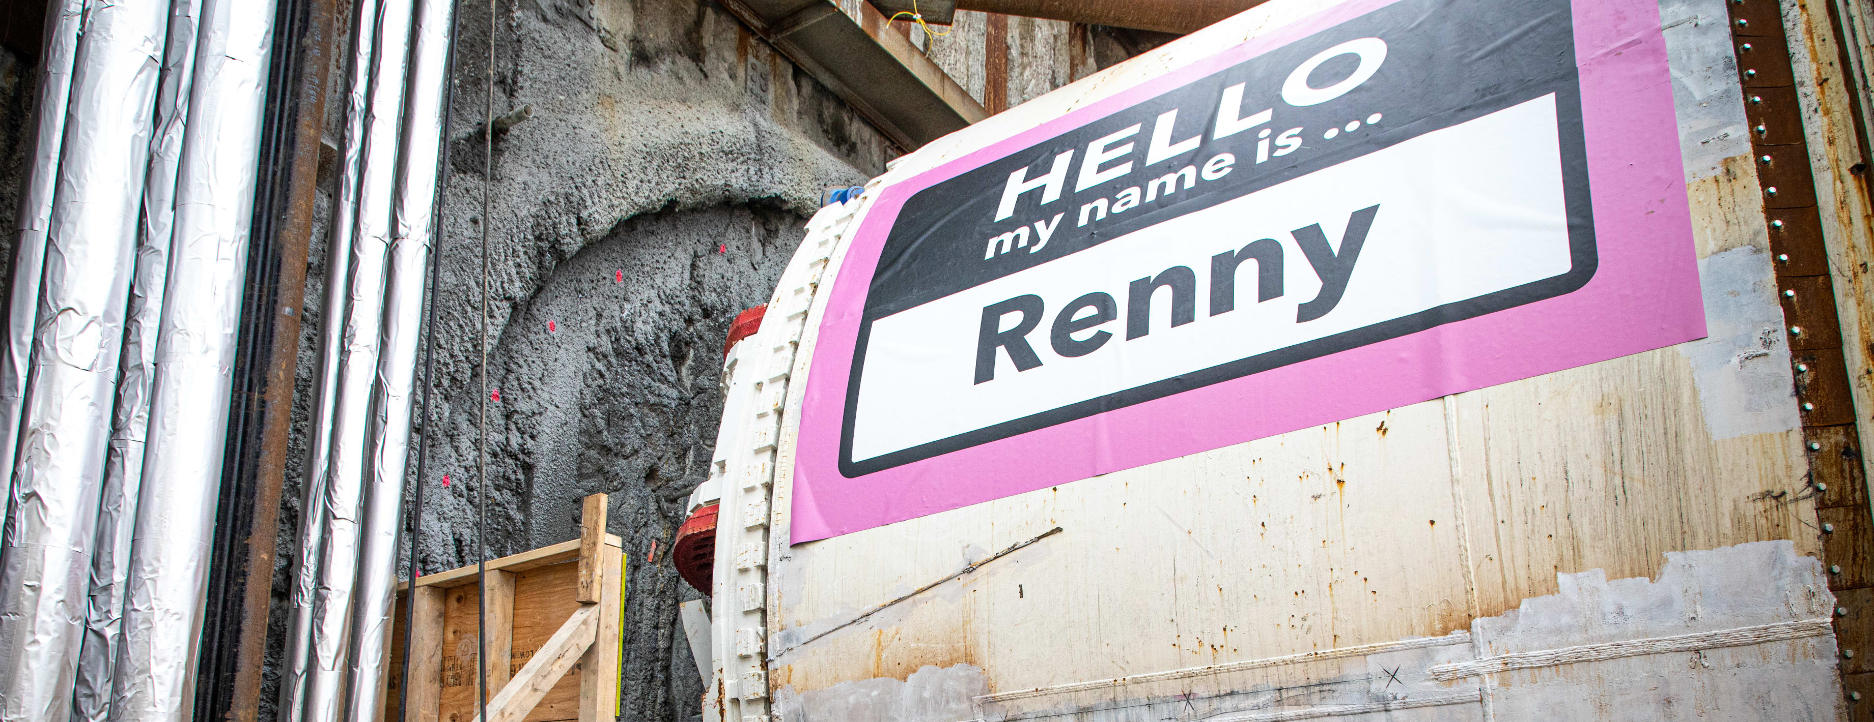
Why Agencies Use Cost‑Reimbursable Contracts
Useful for complex megaprojects where uncertainty makes fixed pricing unreliable or excessively conservative.
Avoids large risk premiums embedded in fixed‑price bids when market conditions are volatile.
Market participants with lower threshold for accepting risk.
Scarborough Subway Extension
Eglinton Crosstown West Extension
18

Slide 19
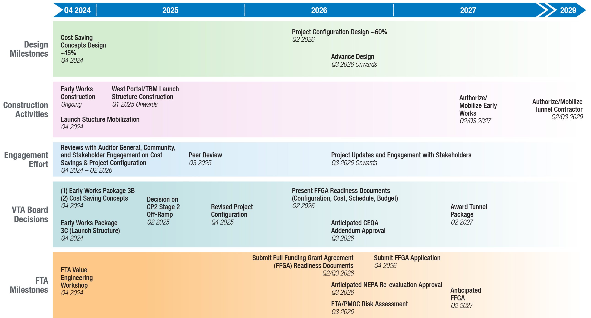
Path to FTA Full Funding Grant Agreement (FFGA)
19
Based on FTA Roadmap, 2025. Subject to Change
Notes:
- VTA expecting to get additional state funding we'll get at CTC Meeting

Slide 20
Diridon Station Design Update

Slide 21
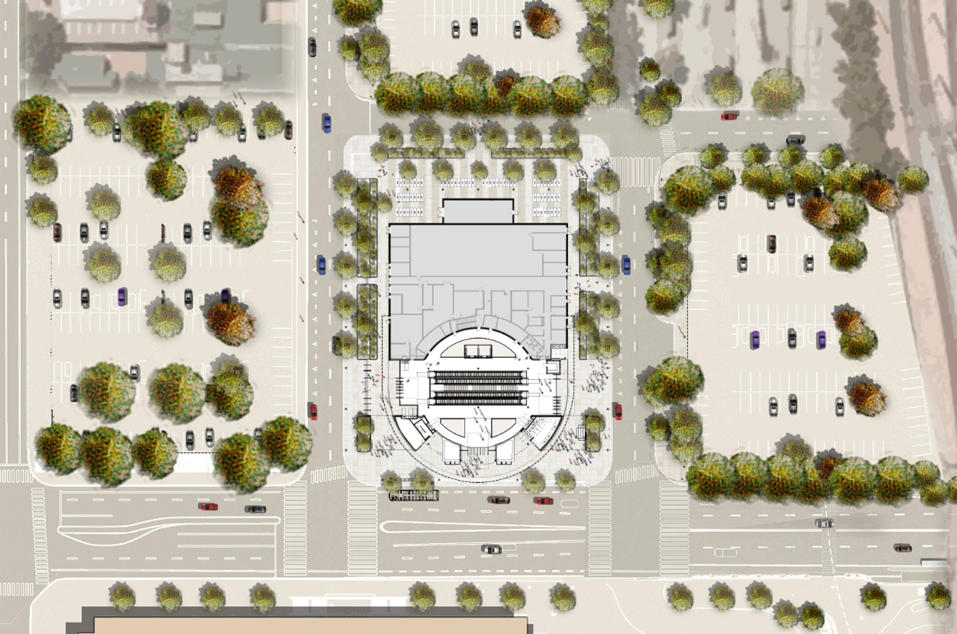
Diridon Site Plan Opening Day
W Santa Clara St
Cahill St
Montgomery St
CONCEPTUAL RENDERING ONLY
21

Slide 22
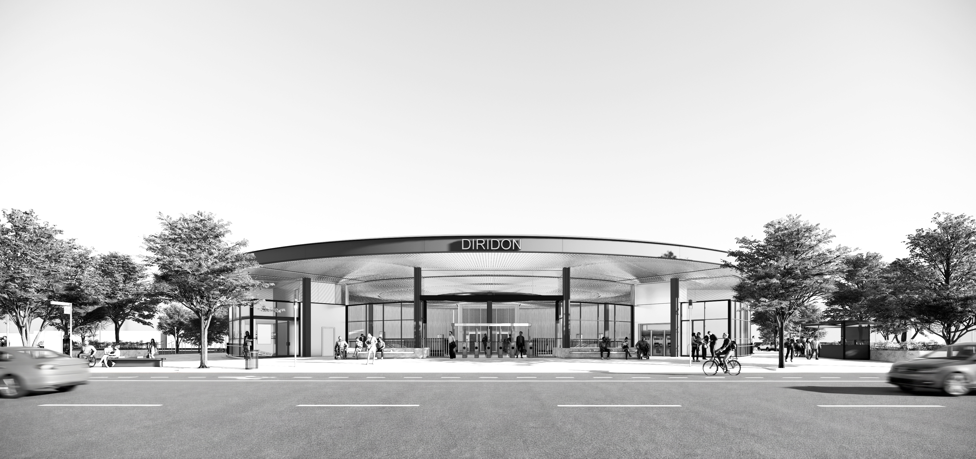
Conceptual Rendering of Diridon BART Station
View looking south at station entrance from West Santa Clara Street
CONCEPTUAL RENDERING ONLY
22
CURRENT as of 03/10/2026 – FOR DISCUSSION ONLY

Slide 23
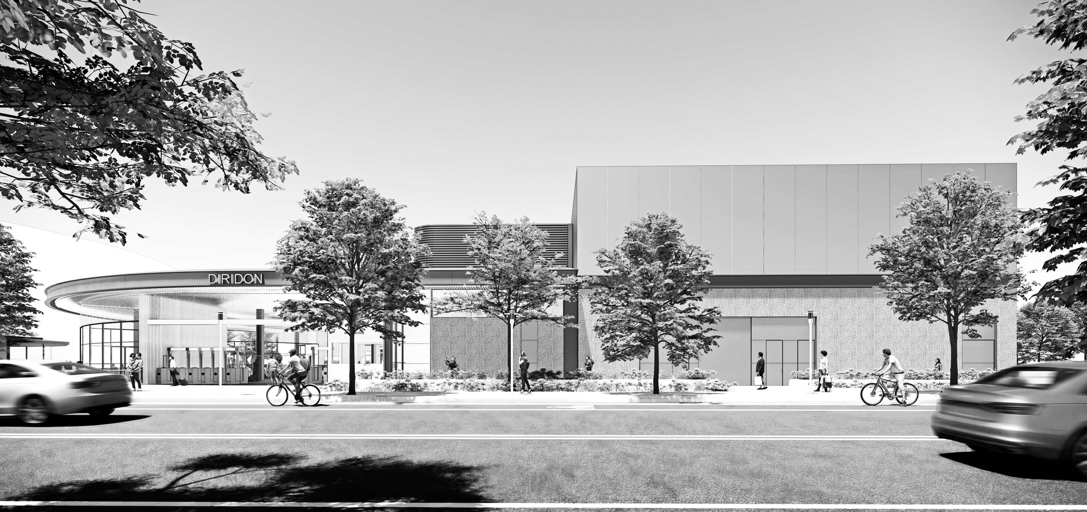
Conceptual Rendering of Diridon BART Station – P2
View looking East from Cahill Street
CONCEPTUAL RENDERING ONLY
23
CURRENT as of 03/10/2026 – FOR DISCUSSION ONLY

Slide 24
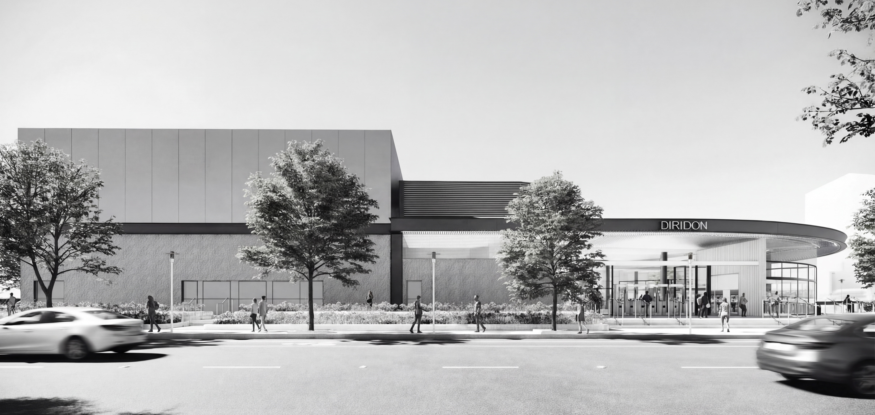
Conceptual Rendering of Diridon BART Station – P3
View looking West from Montgomery Street
CONCEPTUAL RENDERING ONLY
24
CURRENT as of 03/10/2026 – FOR DISCUSSION ONLY
Notes:
Ask for feedback at the next meeting.

Slide 25
Construction Update

Slide 26
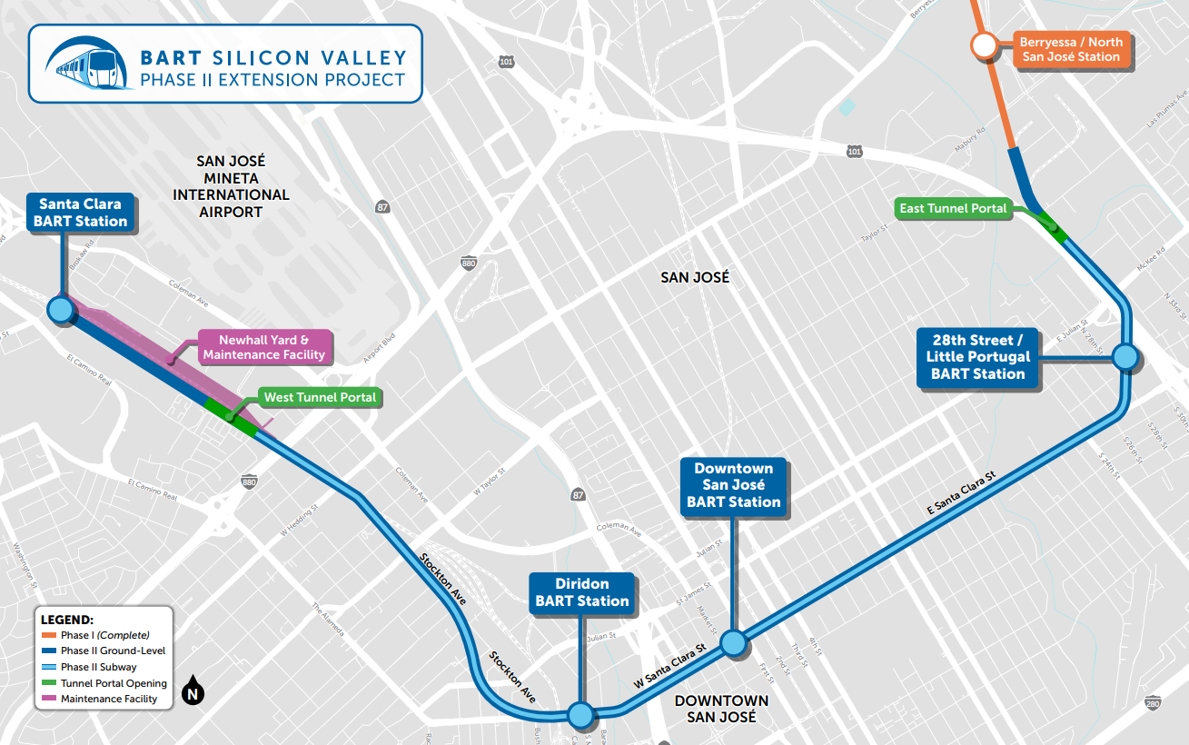
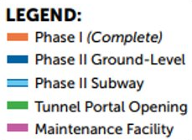

West Portal Construction Area

Slide 27
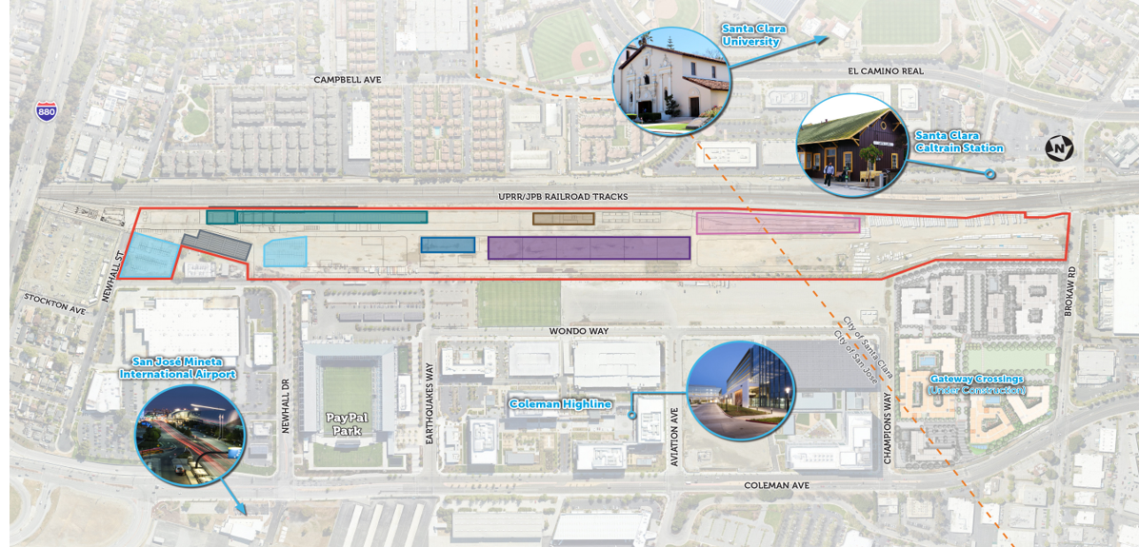
West Portal Construction Area – P2
27

Slide 28
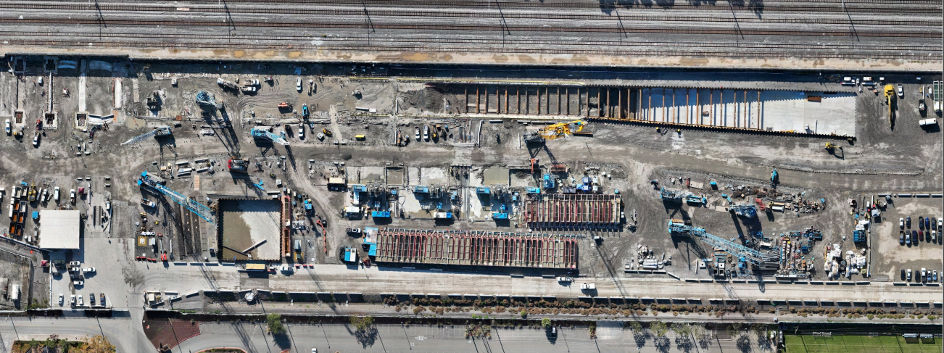
Aeriel View of Tunnel Launch Structure
180’
Caterpillar Shaft
~340’
Cut & Cover
375’
U-Wall
420’
Sheet Piles
D-Walls at CAT Shaft and Cut & Cover in Progress
Excavation and Bracing in Progress
Completed Working Slabs
Stormwater Detention Pond
Bentonite Tanks
As of: November 24, 2025
28

Slide 29
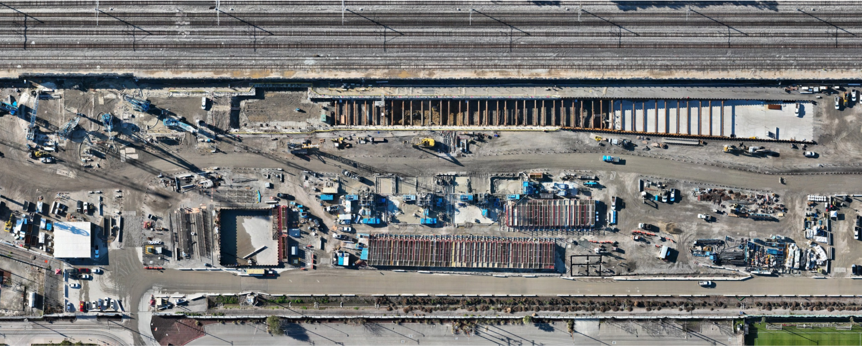
Aeriel View of Tunnel Launch Structure – P2
180’
Caterpillar Shaft
~340’
Cut & Cover
375’
U-Wall
420’
Sheet Piles
D-Walls at CAT Shaft and Cut & Cover in Progress
Excavation and Bracing in Progress
Completed Working Slabs
Stormwater Detention Pond
Bentonite Tanks
As of: January 15, 2026
29

Slide 30
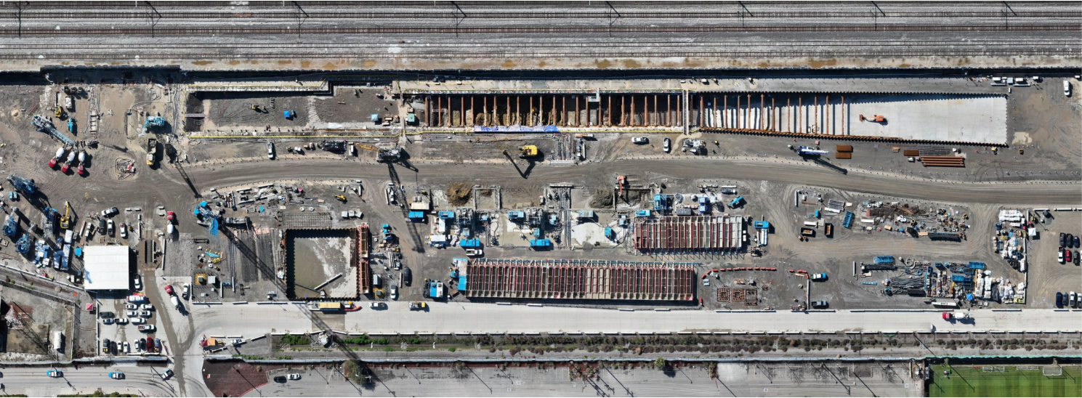
Aeriel View of Tunnel Launch Structure – P3
180’
Caterpillar Shaft
~340’
Cut & Cover
375’
U-Wall
420’
Sheet Piles
Excavation and Bracing in Progress
Completed Working Slabs
D-Walls at CAT Shaft in Progress
Stormwater Detention Pond
Bentonite Tanks
As of: February 12, 2026
30

Slide 31
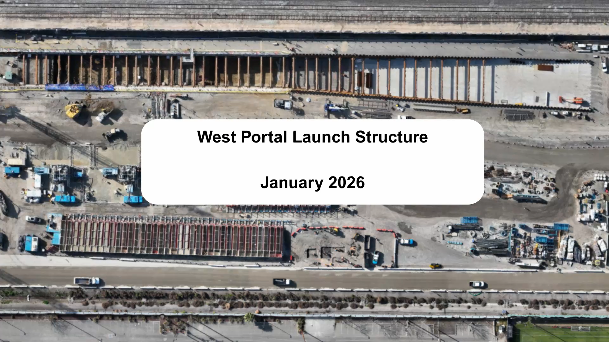
Construction Progress- January

Slide 32
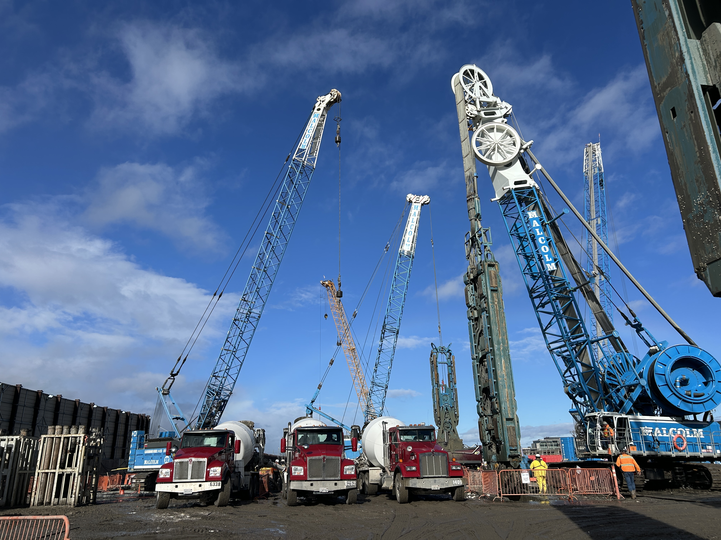
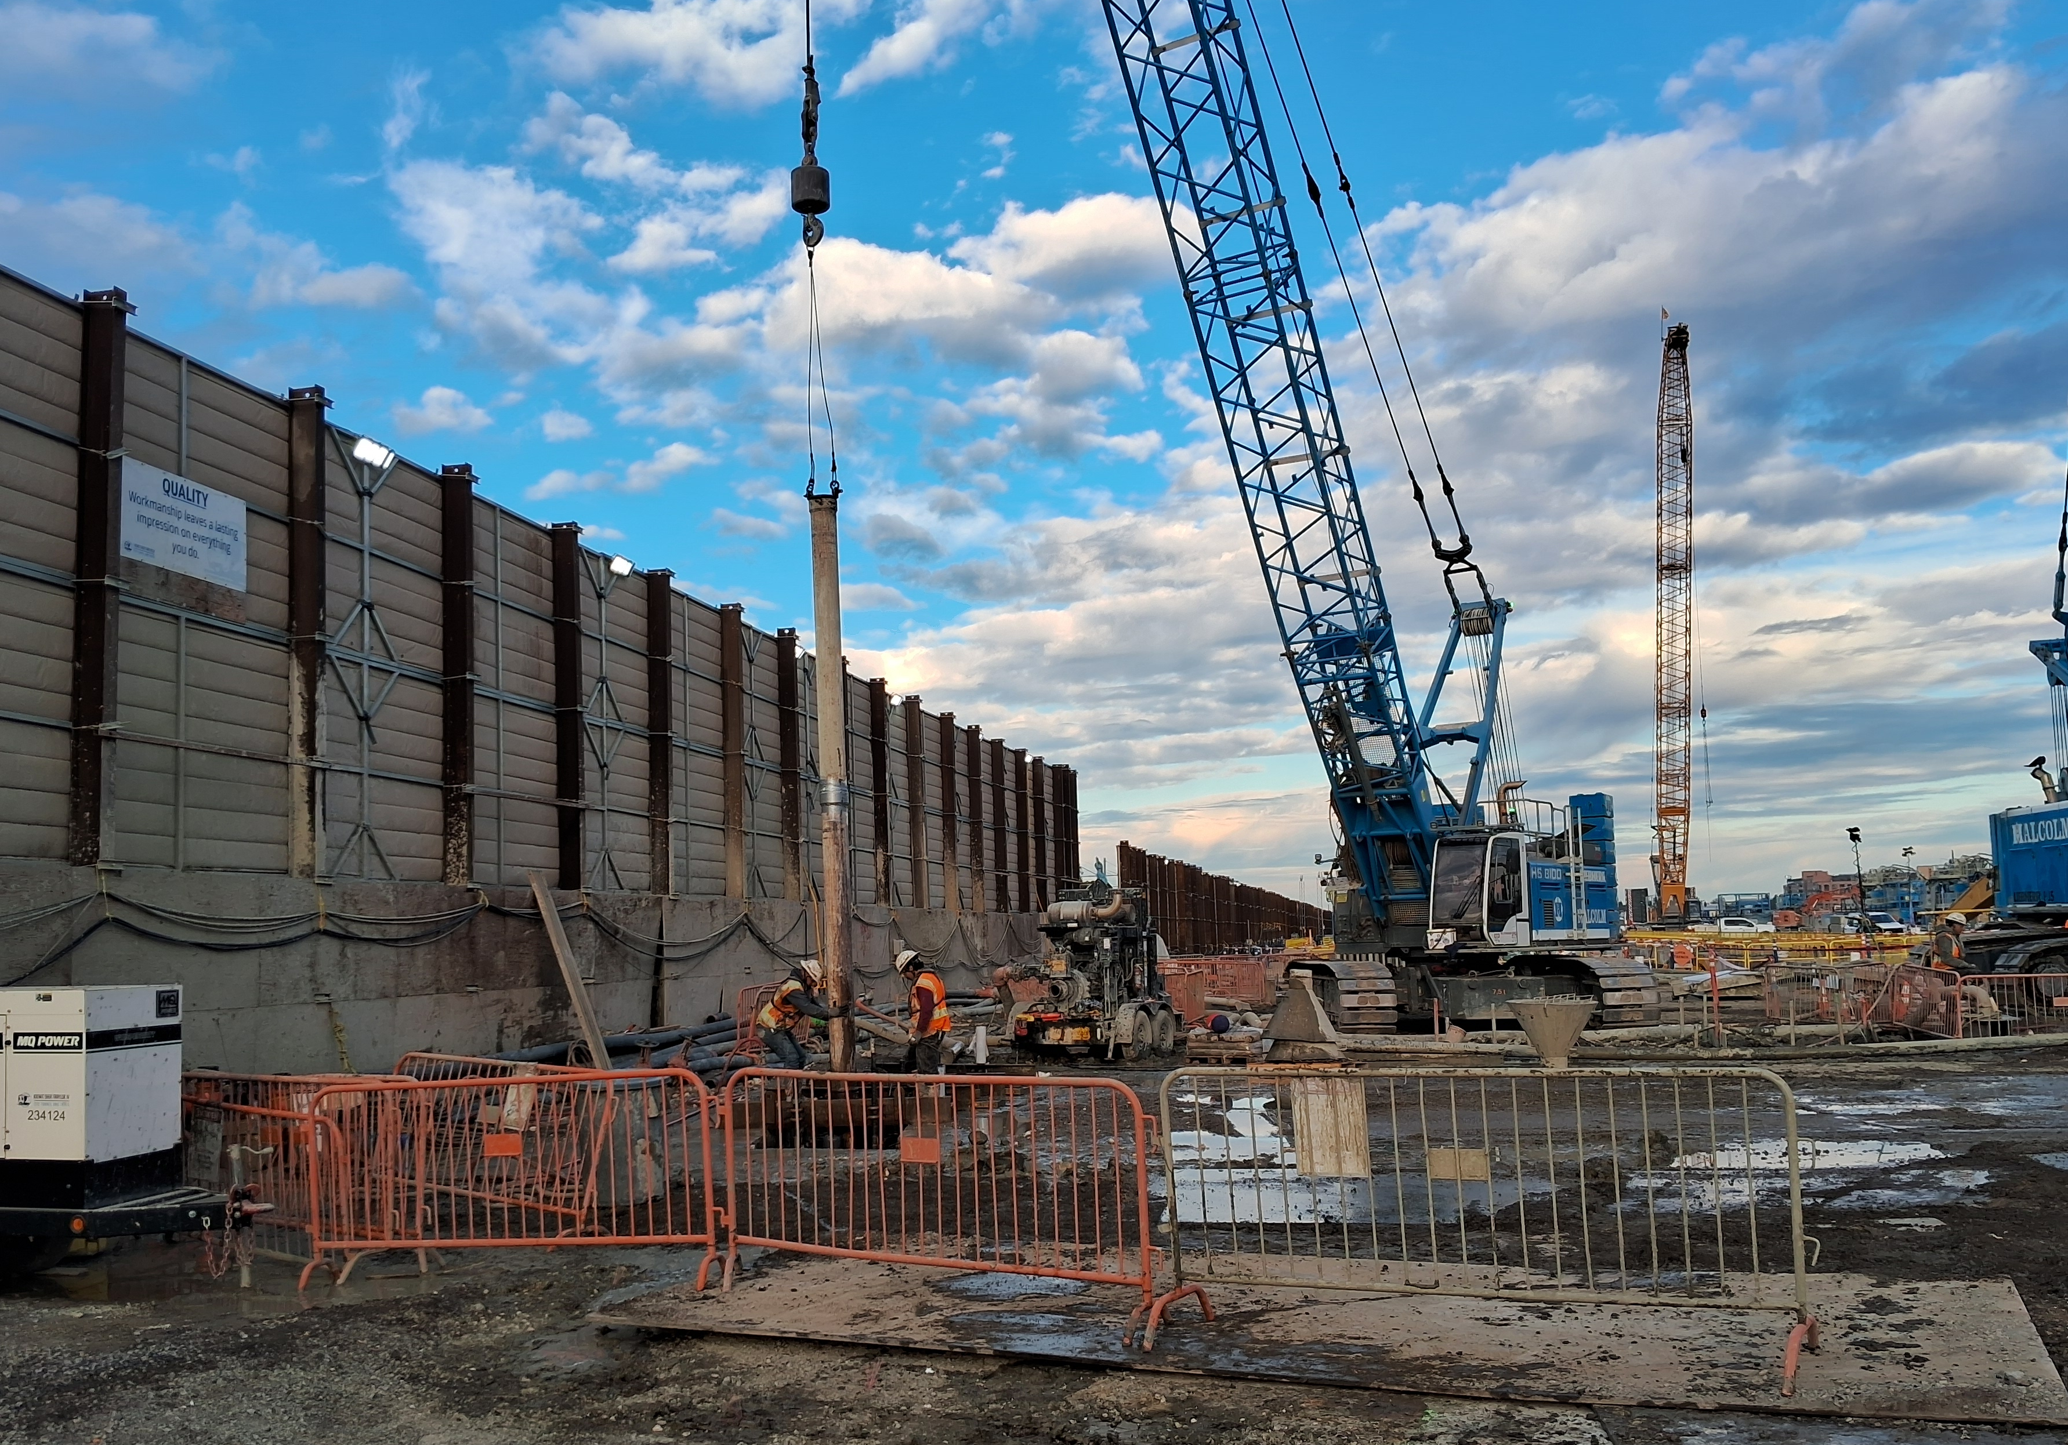
Construction Progress
Caterpillar Shaft Concrete Pour -
Discharge of Concrete
Caterpillar Shaft Concrete Pour -
Setup of Tremie Pipe
Notes:
Caterpillar Shaft Concrete Pour Operation-Discharge of Concrete (Left):
Status – Caterpillar Shaft D-Walls are approximately 50% complete
Purpose – Caterpillar Shaft D-Walls form the arches around the Caterpillar Shaft as part of the Support of Excavation system for the West Portal Launch Structure
Caterpillar Shaft Concrete Pour Operation- Setup of Tremie Pipe (Right):
Status – Caterpillar shaft D-Walls are approximately 50% complete
Purpose – Caterpillar Shaft D-Walls form the arches around the Caterpillar Shaft as part of the Support of Excavation system for the West Portal Launch Structure

Slide 33
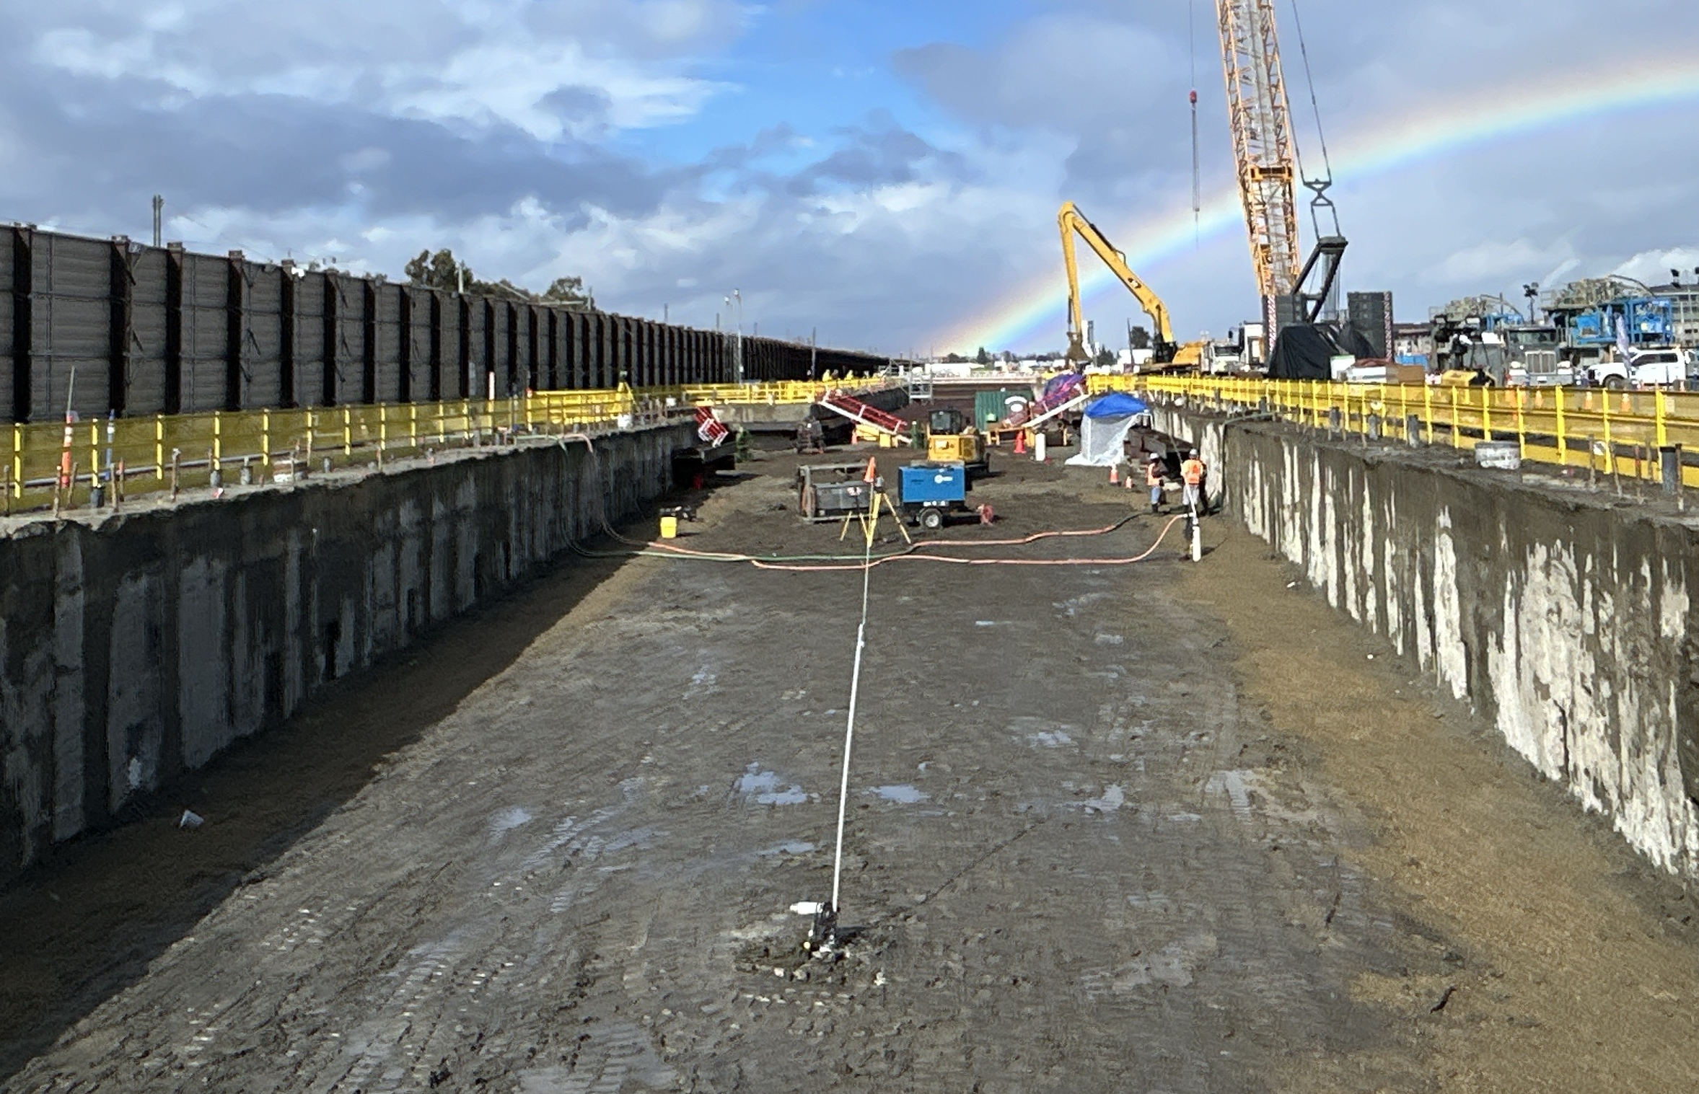
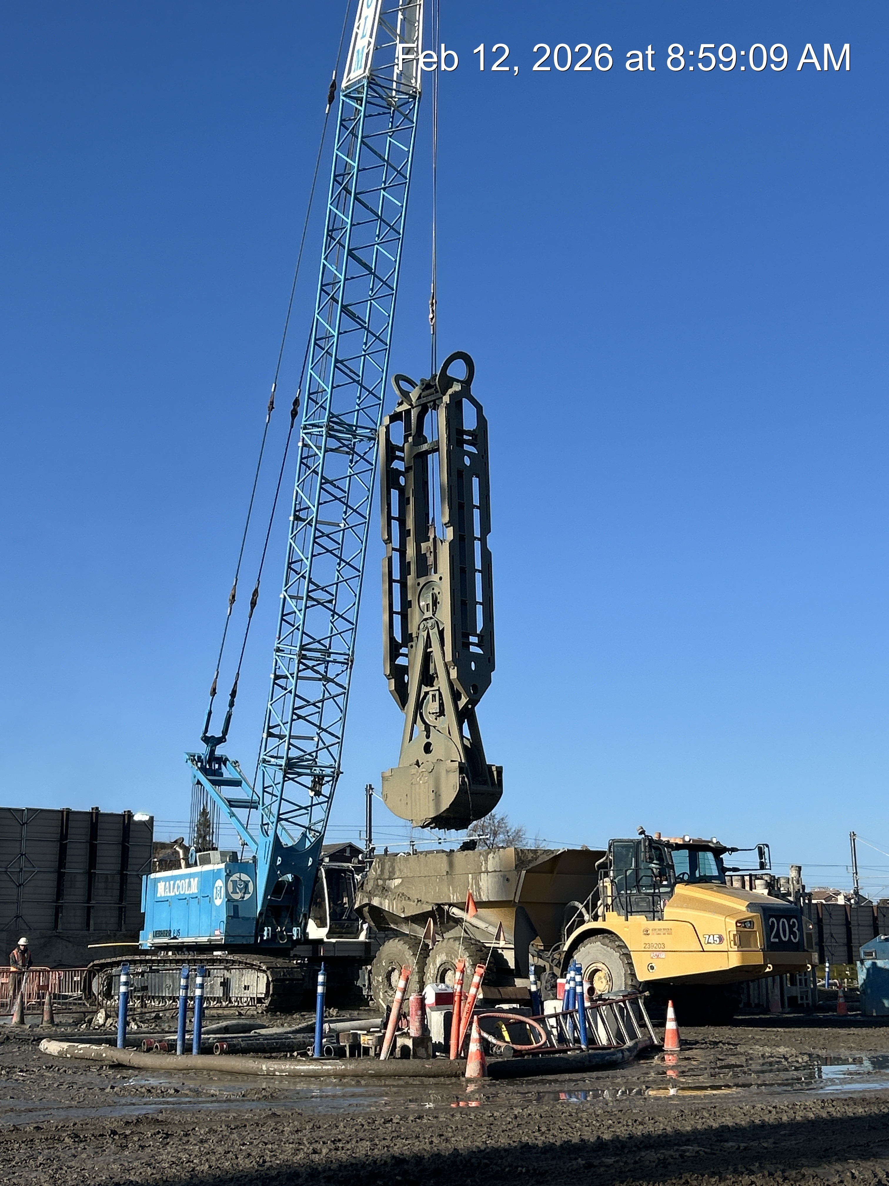
Construction Progress – P2
Cut and Cover Level 1 Excavation
Excavation Utilizing Mechanical Grab
Notes:
Cut and Cover Level 1 Excavation Overview Looking North (Left):
Status - Excavation in the Cut and Cover area is approximately 15% complete.
Purpose – Following the construction of the D-Walls at the U-Wall and Cut & Cover locations, excavation of the launch structure is underway. Bracing elements are installed to support the wall as excavation progresses deeper.
Caterpillar Shaft D-Wall Excavation utilizing the Mechanical Grab (Right)
Status – Caterpillar shaft D-Walls are approximately 50% complete.
Purpose – Caterpillar Shaft D-Walls form the arches around the Caterpillar Shaft as part of the Support of Excavation system for the West Portal Launch Structure.

Slide 34
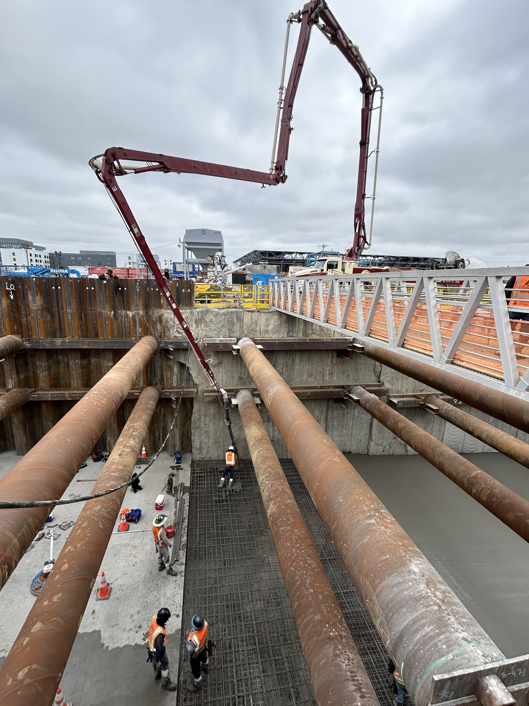
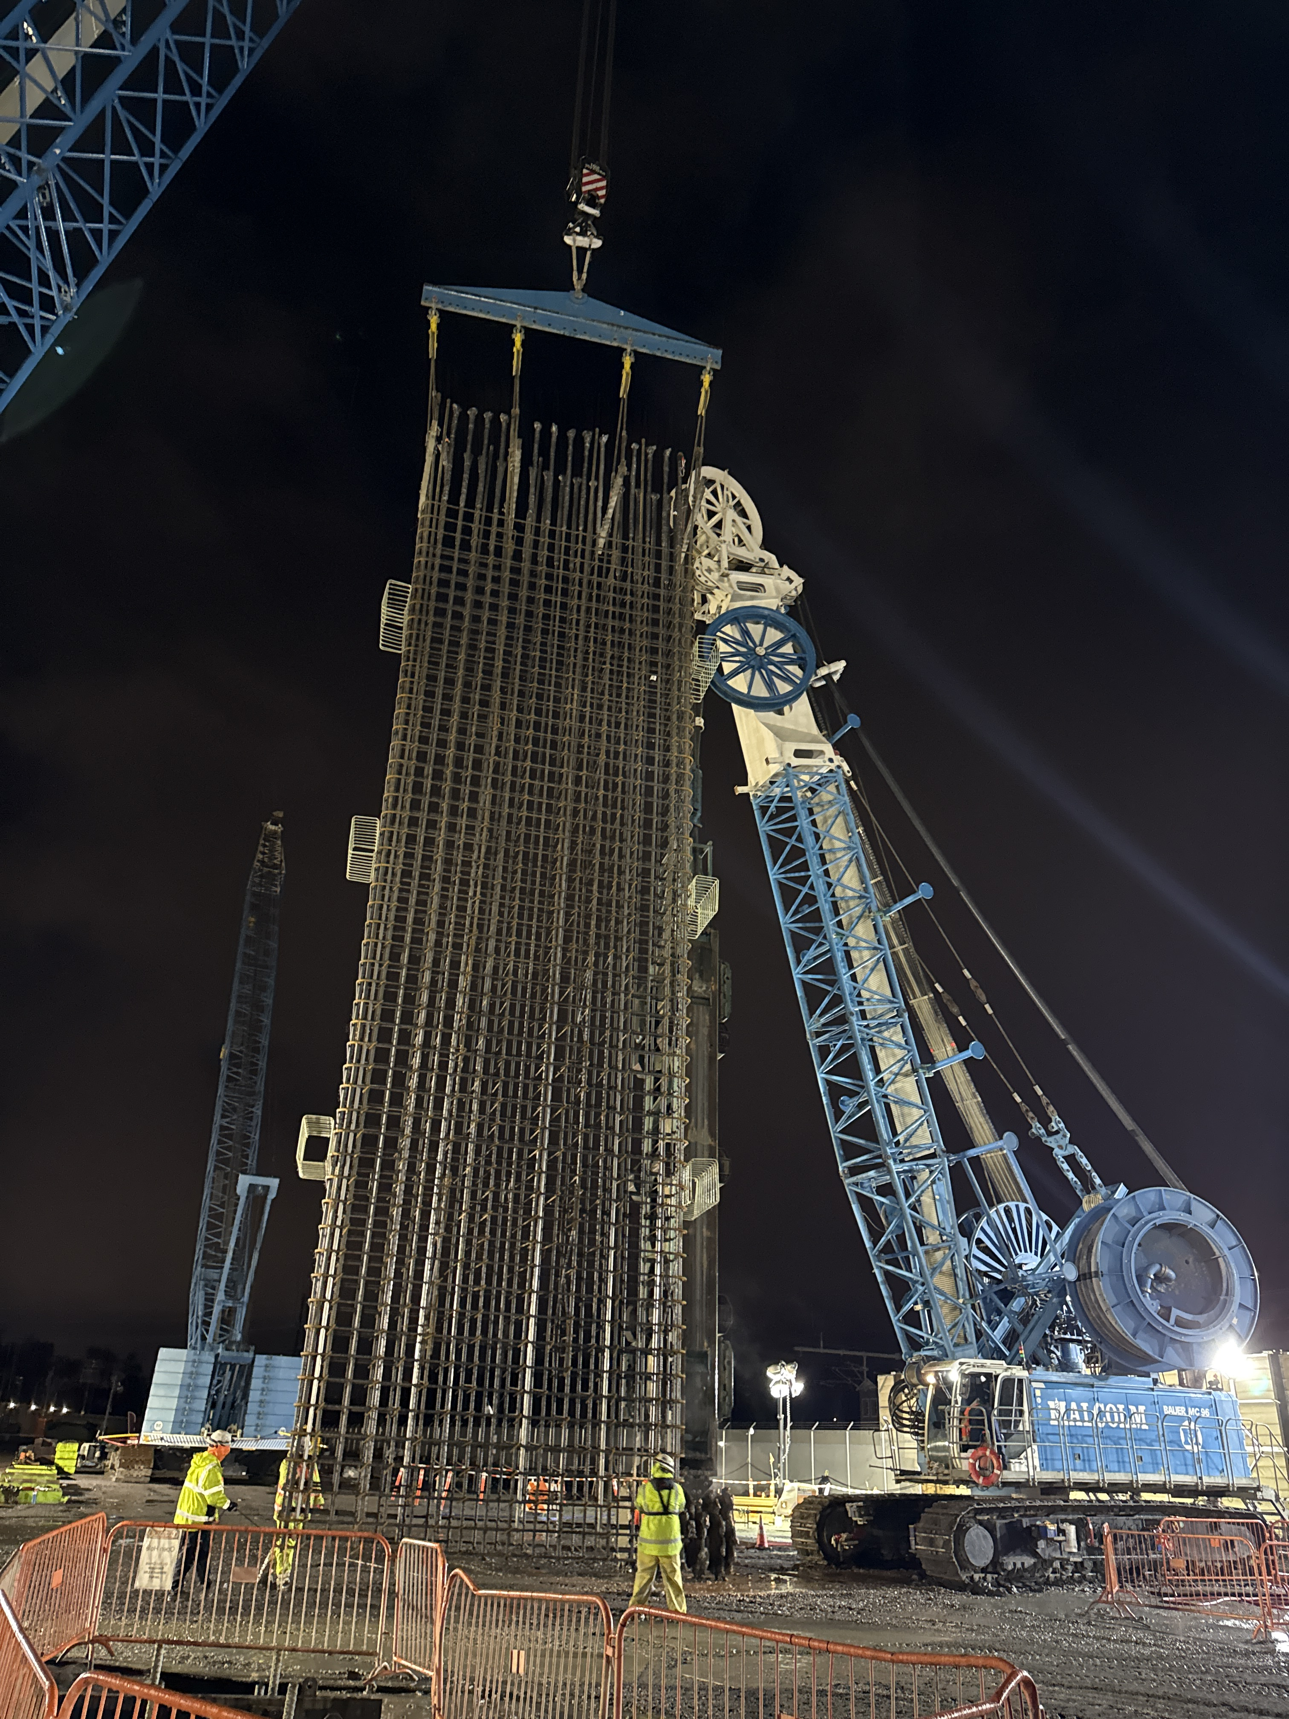
Construction Progress – P3
Concrete Working Slab Pour
Caterpillar Shaft Crosswall Rebar Cage Lifting
Notes:
U-Wall Concrete Working Slab Concrete Pour Operations (Left)
Status – U-Wall concrete working slabs are approximately 25% complete.
Purpose – After excavation is complete along the West Portal Launch Structure ramp, a concrete working slab is poured which will form a solid surface to support the future tunneling operations.
Caterpillar Shaft Crosswall Rebar Cage Lifting Operation (Right):
Status – Caterpillar shaft crosswalls are approximately 60% complete.
Purpose – Caterpillar Shaft crosswalls separate the three cells in the Caterpillar shaft during excavation and provide foundations for the concrete working slabs.

Slide 35
Next Steps

Slide 36
2026 Downtown-Diridon CWG Meeting Dates
Tuesday, June 9, 2026
Topics will include:
  BSVII Update, Funding, Station Design
  Muck Update
  Construction Transportation Management Plan (CTMP) for Downtown/Diridon
  Diridon Station parking lot closure
Potential Mid-May and/or Mid-July additional Interim Downtown CWG meetings to be planned
  Plaza, station façade treatments and finishes, interior review, etc.

Slide 37
2026 Downtown-Diridon CWG Meeting Dates -
Tuesday, September 15, 2026
Tuesday, November 17, 2026

Slide 38
Upcoming VTA Meetings
VTA's BART Silicon Valley Phase II Oversight Committee
Thursday, March 12, 2026 | 12:00 PM
Thursday, April 9, 2026 | 12:00 PM
Thursday, May 14, 2026 | 12:00 PM
Thursday, June 11, 2026 | 12:00 PM
VTA BOARD OF DIRECTORS MEETING
Thursday, April 2, 2026 | 5:30 PM
Thursday, May 7, 2026 | 5:30 PM
Thursday, June 4, 2026 | 5:30 PM

Slide 39
Questions?

